Slide 1
Netflix Recommender System
Presented By:
Nirajan Bekoju
Machine Learning Engineer
FuseMachines

Slide 2
Netflix Recommender System
Historically, the netflix recommendation problem has been thought of as equivalent to the problem of predicting the number of stars that a person would rate a video after watching it, on a scale from 1 to 5.

Slide 3
Recommendation algorithm of Netflix
Personalized Video Ranker(PVR)
Top-N Video Ranker
Trending Now Ranker
Continue Watching Ranker
Video-Video Similarity Ranker
Page Generation: Row Selection and Ranking
Evidence Selection
Search

Slide 4
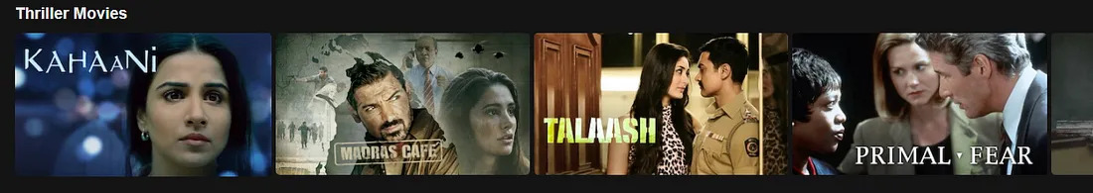
Personalized Video Ranker(PVR)
Genre Recommendations for each member on Netflix’s home page are driven and individualized by PVR
The resulting ordering is used to select the order of the videos in genre and other rows, and is the reason why the same genre row shown to different members often has completely different videos.

Slide 5
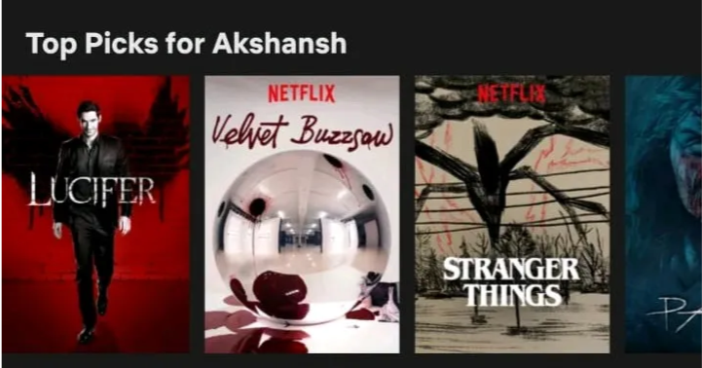
Top-N Video Ranker
This algorithm is used to determine each users ‘Top Picks’ row and find a few, best personalized recommendations for each member.
Similar to Personalized Video Ranker, but it only looks at the head of the rankings and looks at the entire catalog.

Slide 6
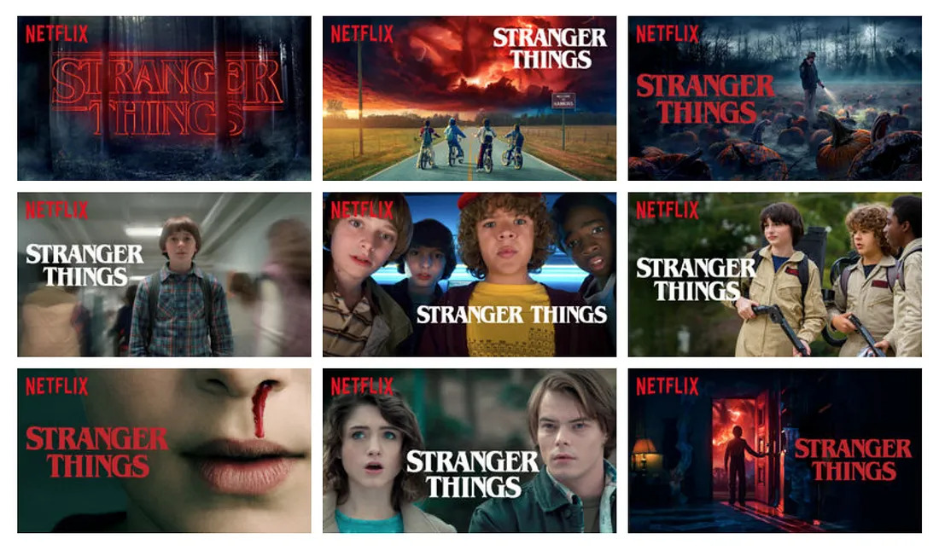
Personalized-Auto Generation of Thumbnails

Slide 7
Personalized Auto-Generation of Thumbnails
Using thousands of video frames, Netflix annotates these images and then ranks each image in an effort to identify which thumbnails have the highest likelihood of resulting in your click.
These calculations are based on what others who are similar to you have clicked on.
One finding could be that uses who like certain actors/movies genres are more likely to click thumbnails with certain actor/image attributes.

Slide 8
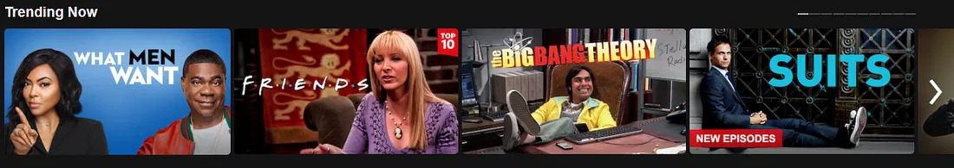
Trending Now Ranker
This algorithm captures temporal trends which Netflix deduces to be strong predictors. These short-term trends can range from a few minutes to a few days.
These events/trends can be events that have a seasonal trend and repeat themselves.
For example: Corona Virus, Earthquake and other disasters lead to short-term interest in documentaries about them.

Slide 9
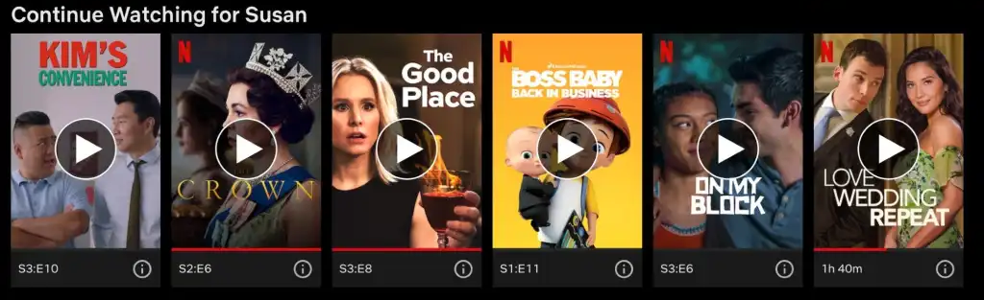
Continue Watching Ranker
This algorithm looks at items that the member has consumed but has not completed, lille episodic content, e.g TV Series

Slide 10
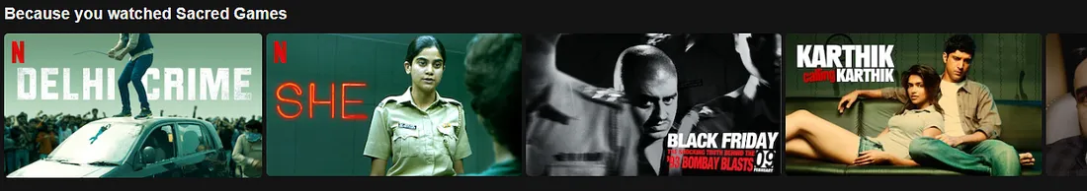
Video-Video Similarity Ranker
The ‘Because You Watched(BYW) This’ row on Netflix’s homepage is another type of categorization.
It might be similar to content-based recommender as it is doing item to item recommendation via a similarity matrix.

Slide 11
Page Generation: Row Selection and Ranking
Page generation uses the recommendations produced from all the above listed algorithms and decides how each page is constructed with relevance and diversity of each row and page taken into consideration.

Slide 12
Evidence Selection
Evidence selection algorithms work together with the above recommendation algorithms to help Netflix members decide if the video is right for them.
Evidence:
Predicted Star Rating for the movie by the user
Awards, cast or other metadata regarding the movie

Slide 13
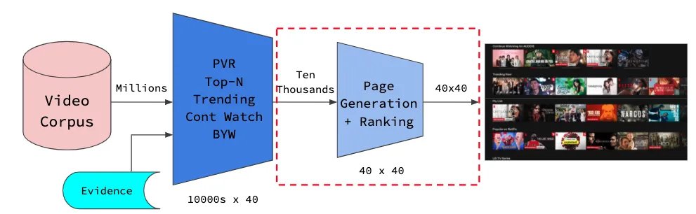
Netflix’s Model Workflow

Slide 14
Search
Members frequently search for videos, actors, or genres in our catalog.
Netfllix leverage information retrieval and related techniques to find the relevant videos and display the to our members.
However,
Members often search for videos, actors or genres that are not in the catalog and hence search turns into a recommendation problem.

Slide 15
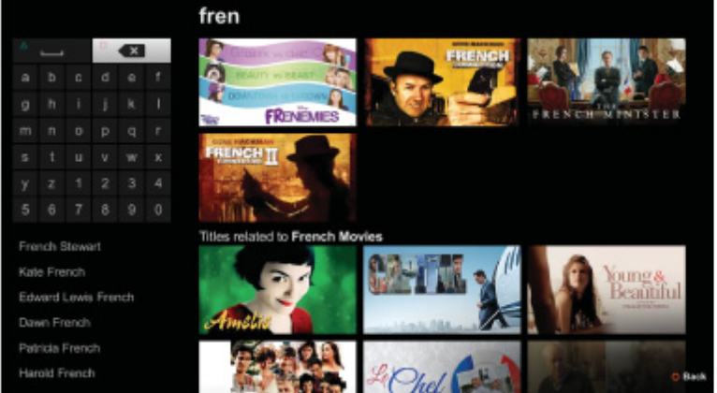
Search experience for the query “fren”, showing standard search results at the top for videos with names that contain the substring “fren”
Search recommendation based on the guess that the intent was searching for french movies

Slide 16
Business Value
80% of hours streamed at Netflix comes from the recommendation system.
20% comes from search, which requires its own set of algorithms.

Slide 17
Thank You

